Slide 1
ECE 188: Team 1
Jasmine Chiang, Richard Chum, Derek Lam
Carousel Project

Slide 2
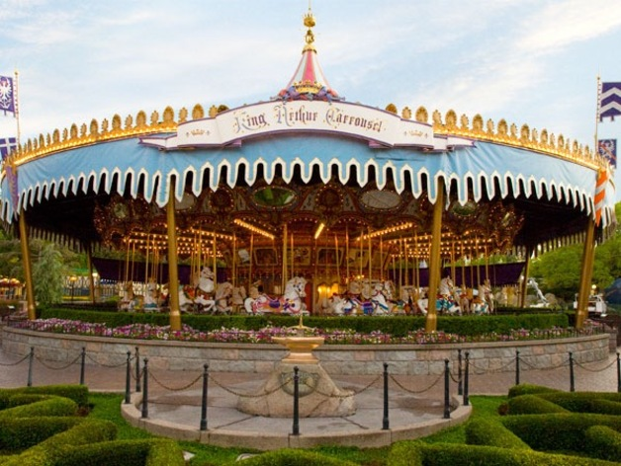
“They say if you dream a thing more than once, it’s sure to come true.”
-Sleeping Beauty
Notes:
Motivation/inspiration:
Ferris wheel project, my wife loves disneyland and sleeping beauty

Slide 3
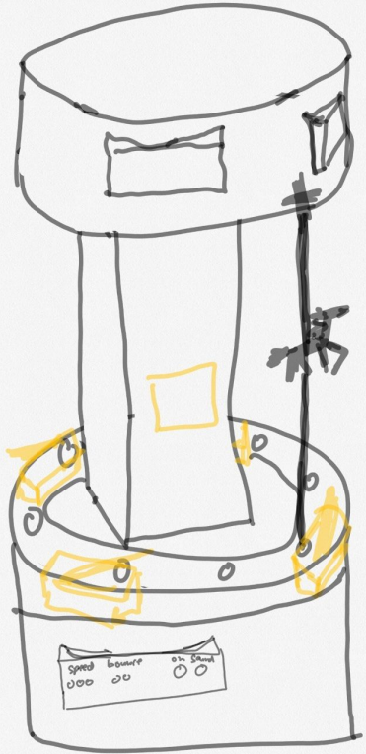
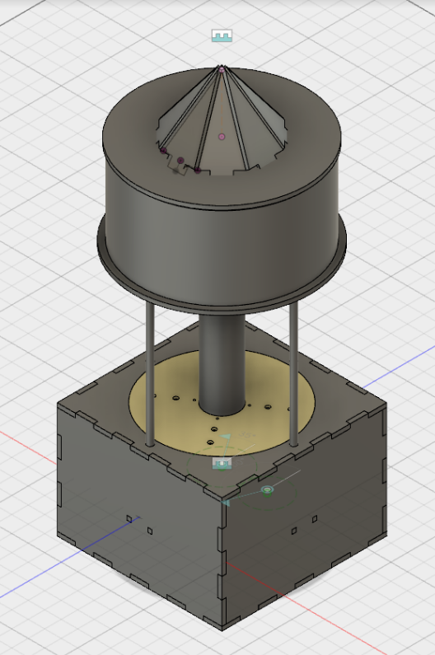

Initial Sketch
Isometric View of CAD

Slide 4
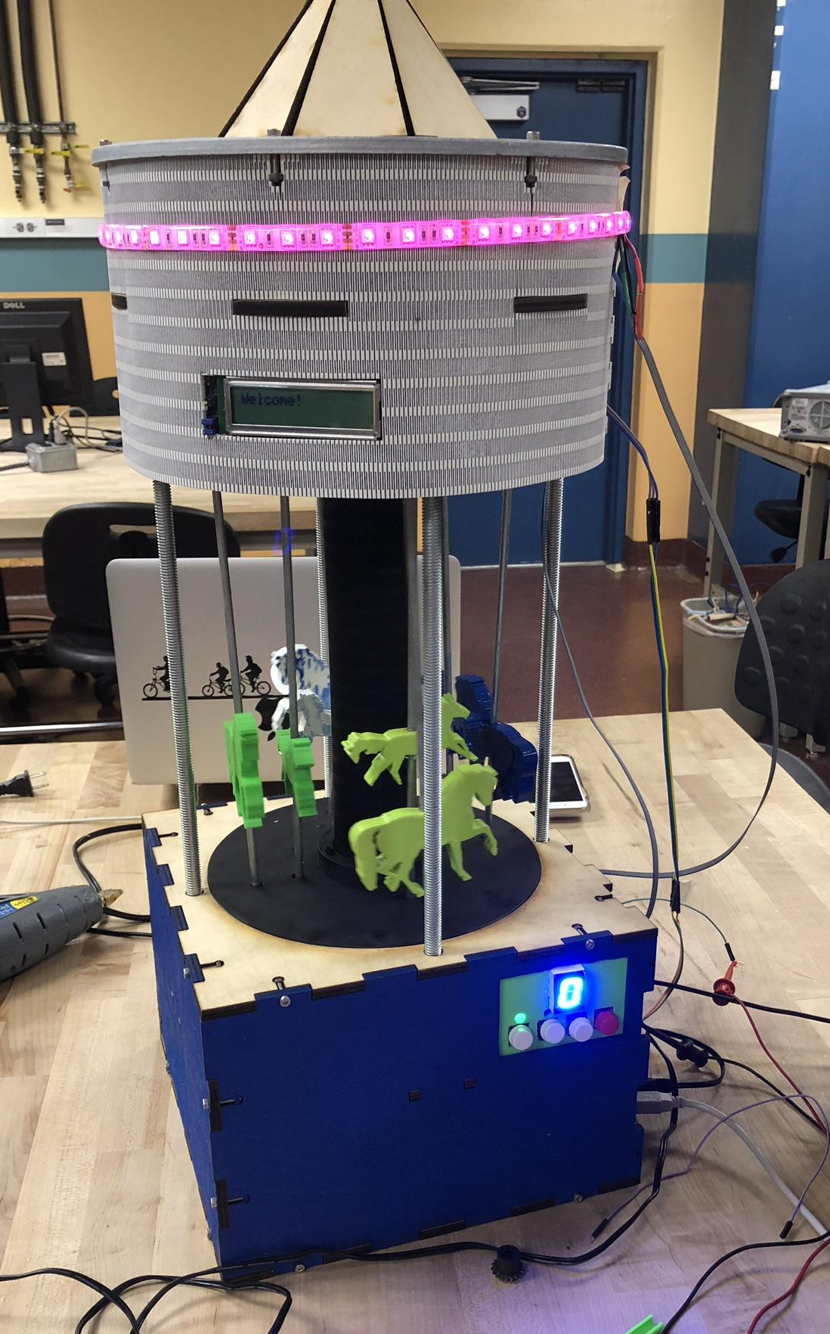
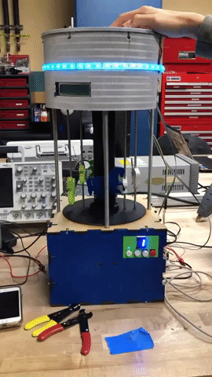
Isometric View of Final Carousel
Final Carousel in Motion

Slide 5
Unique Features

Slide 6
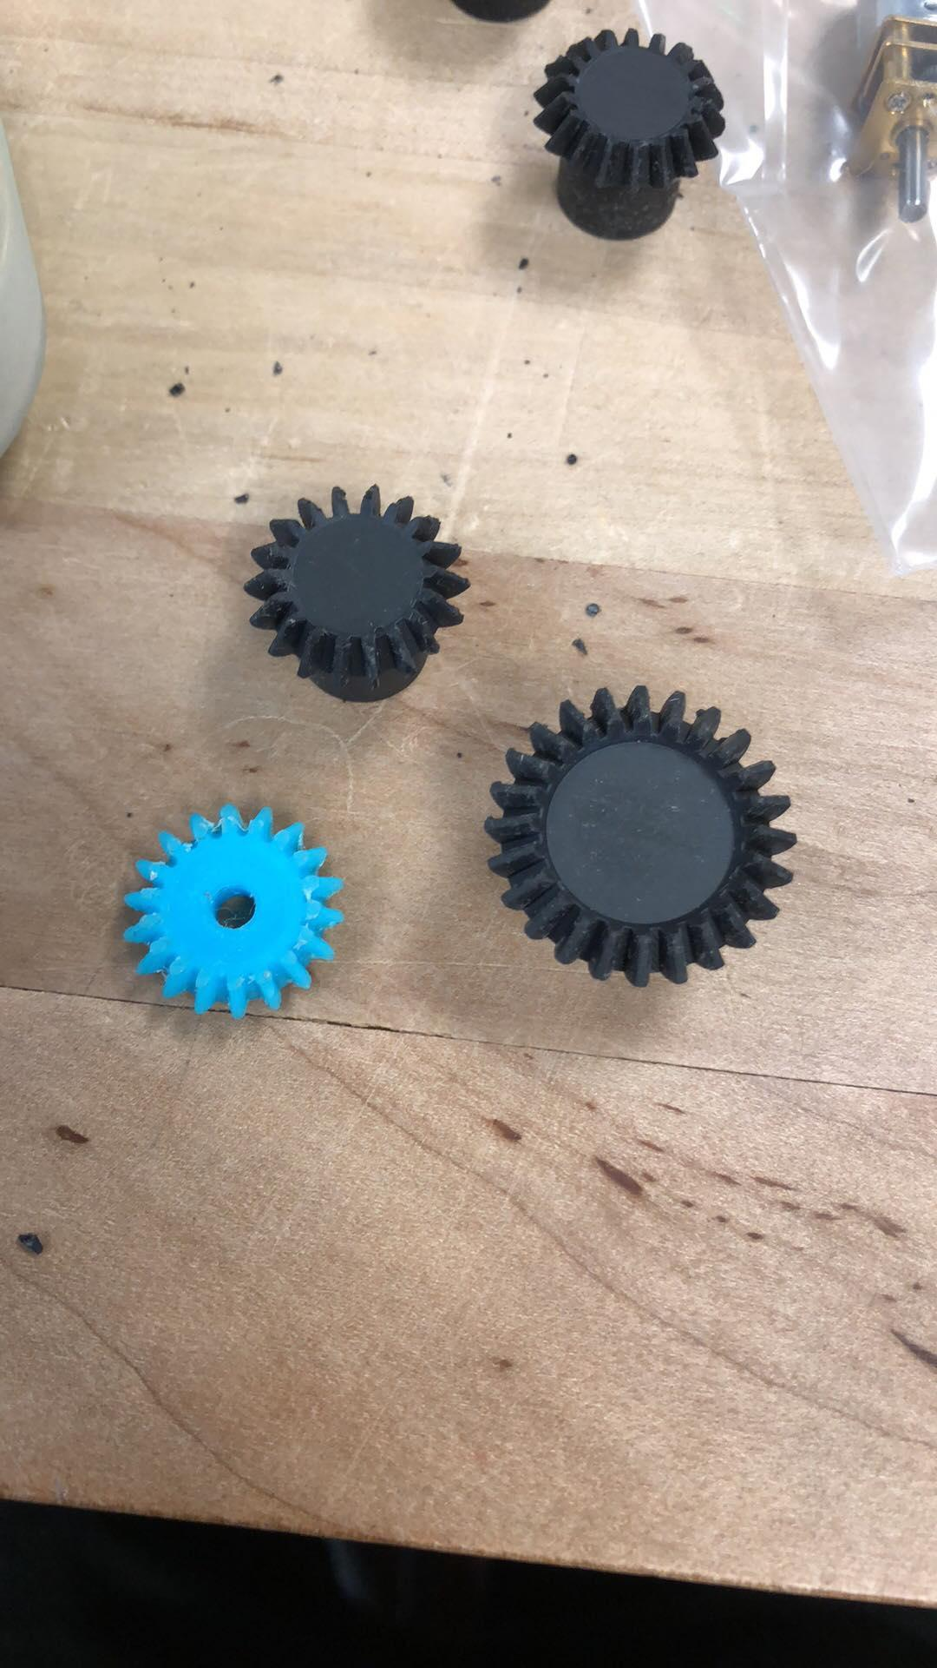
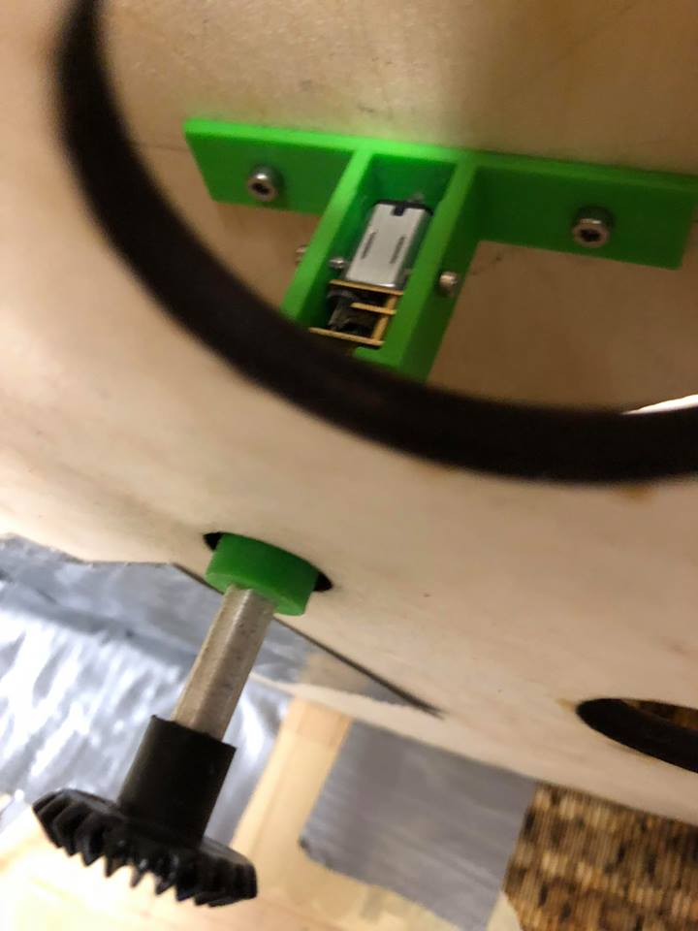
Top Gears
Comparison of original and final bevel gears
Bevel gear attached to top motor
Motor gear sits atop four bevel gears
Notes:
Photo on right: talk about how the crankshaft is attached to to motor mounts which are attached to the bevel gears. The bevel gear attached on motor pictured in center sits atop the 4 gears to move it all. Explain mechanism.

Slide 7
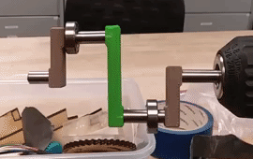
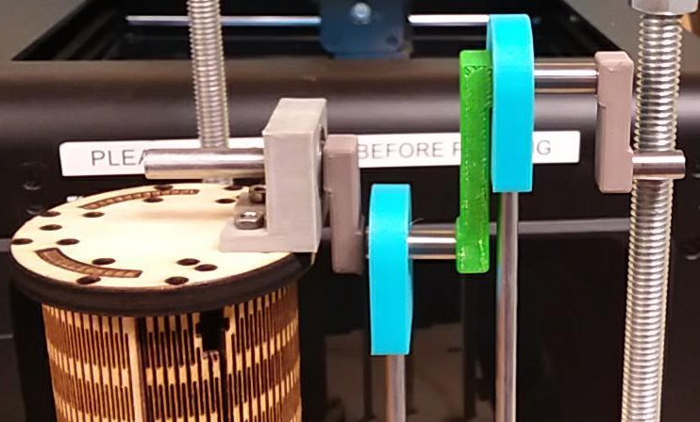
Crankshafts
Working Crankshaft in motion
Crankshaft on mount with rod adapter

Slide 8
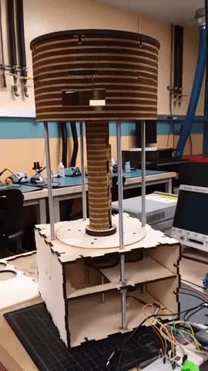
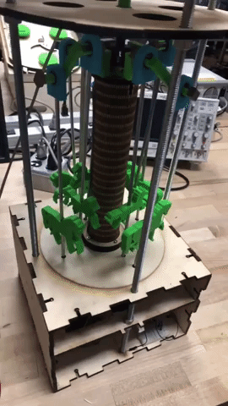
Types of Motion
Bottom gears control rotation of base
Crankshaft drive vertical motion of the horses

Slide 9
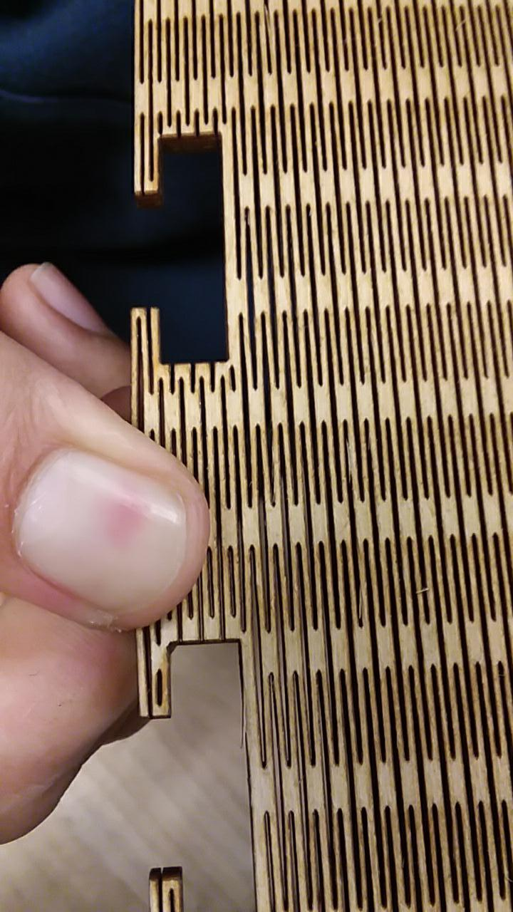
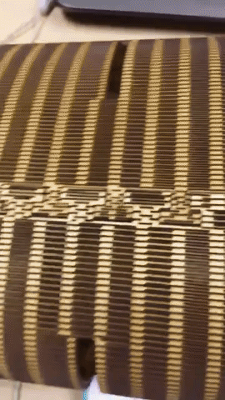
Living Hinge
Extension on Inkscape to make wood malleable (SiteSwapJuggler)
Difficult to adjust around borders
Time consuming
Overall very delicate to work with
Notes:
https://github.com/siteswapjuggler/Inkscape_LivingHinge

Slide 10
Code

Slide 11
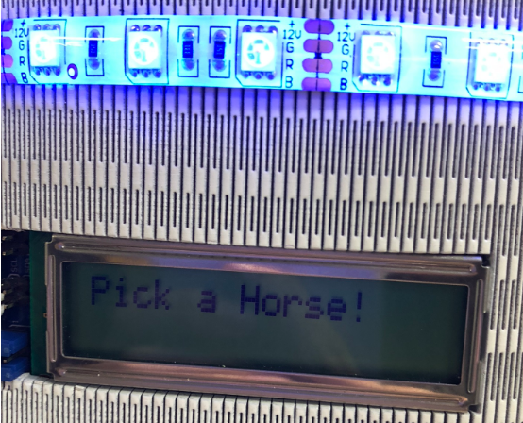
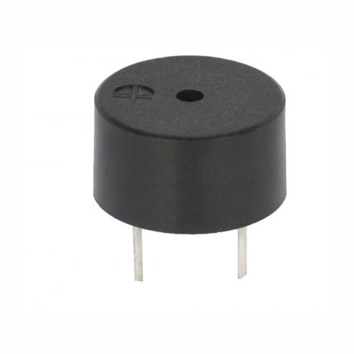
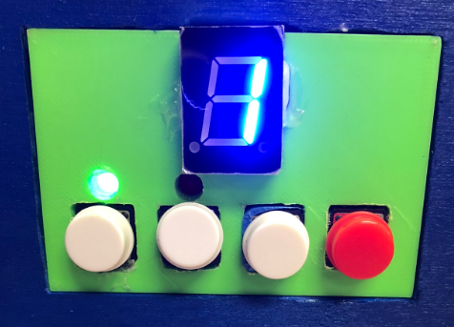
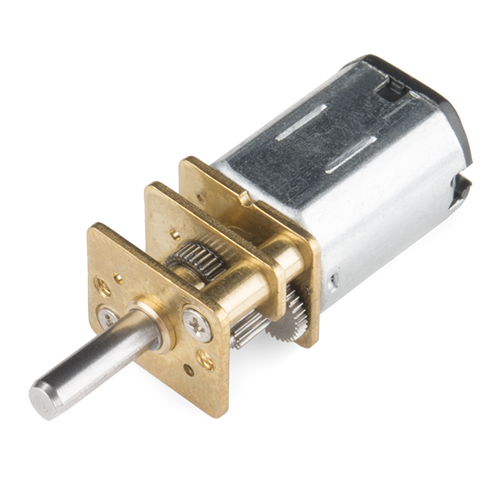
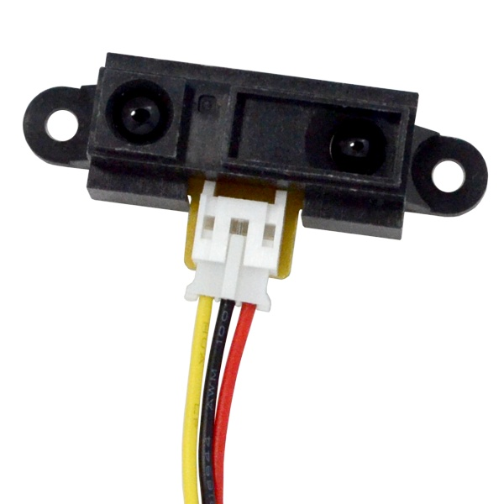
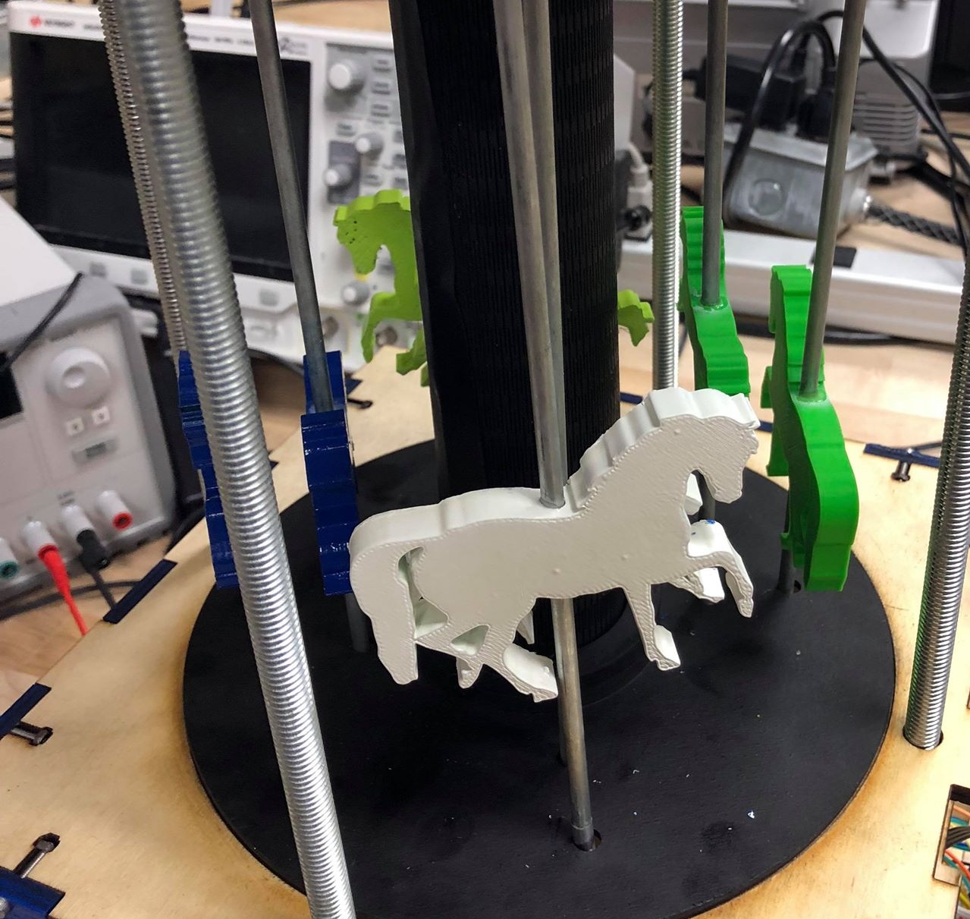
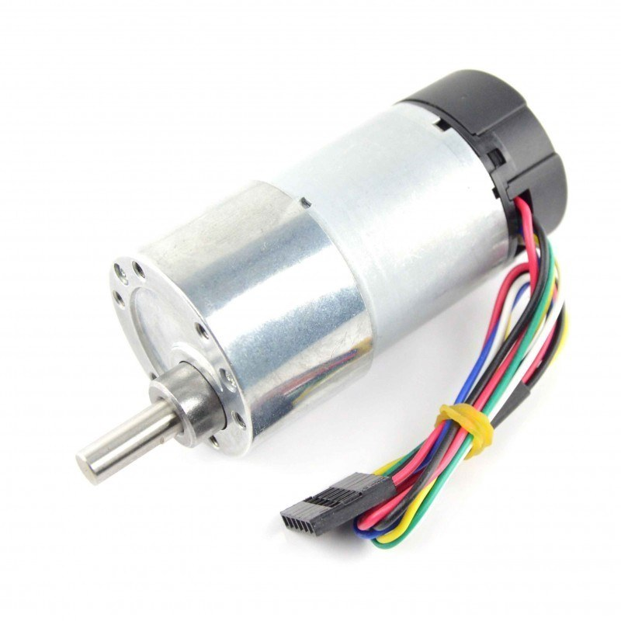
State Diagram
User selects Ride Mode
Carousel continuously spins
Turn on Carousel
Calibrate encoder position with IR
Standby Mode
User selects which horse to ride
Horse moves to front of carousel

Slide 12



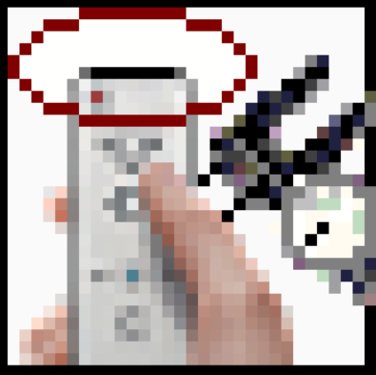






SubVIs
Seven
Segment
RGB LED Strip Cycle
Buzzer Music
IR Sensor for Calibration
LCD Display
Bottom Motor Duty Cycle
Top Motor Duty Cycle
PID for Bottom Motor RPS
PID for Bottom Motor Position
Encoder

Slide 13
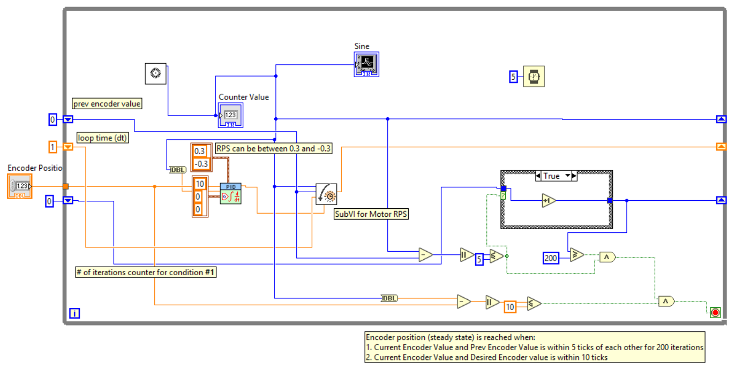
SubVI - Motor Shaft Position

Slide 14
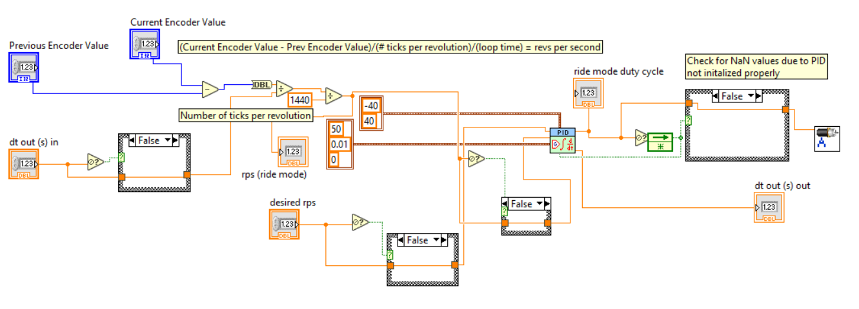
SubVI - Motor RPS

Slide 15
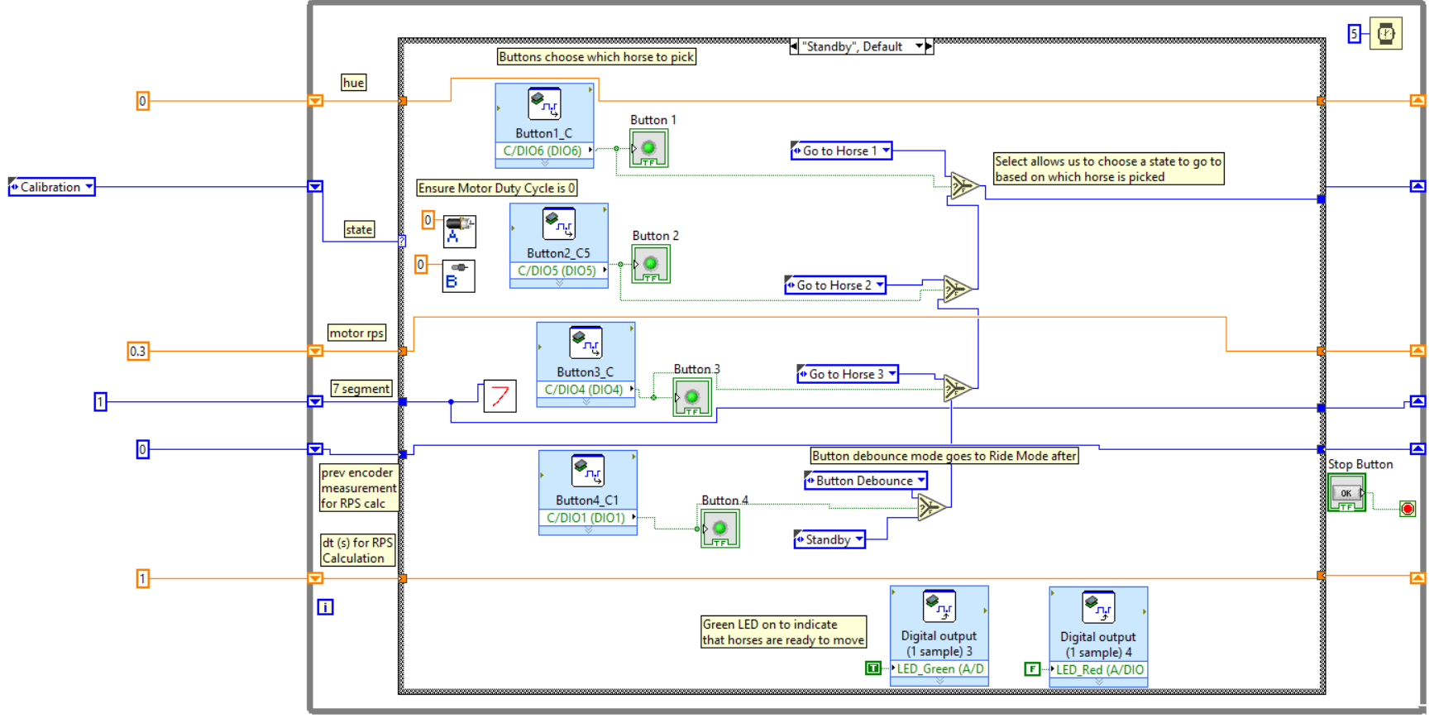
Standby Mode

Slide 16
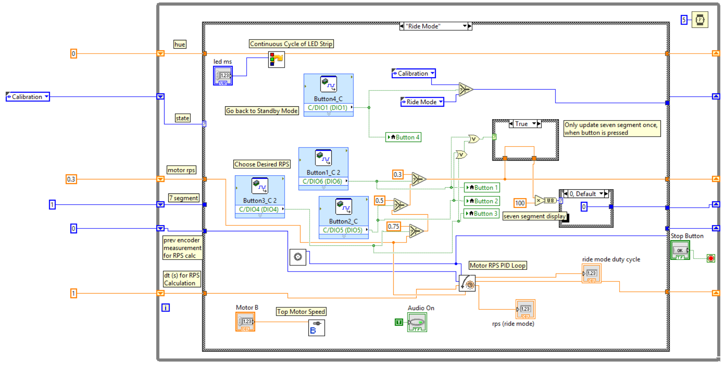
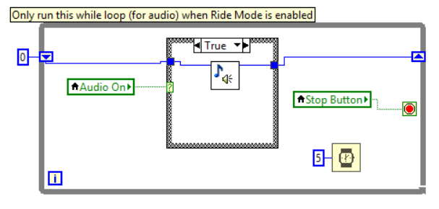
Ride Mode

Slide 17
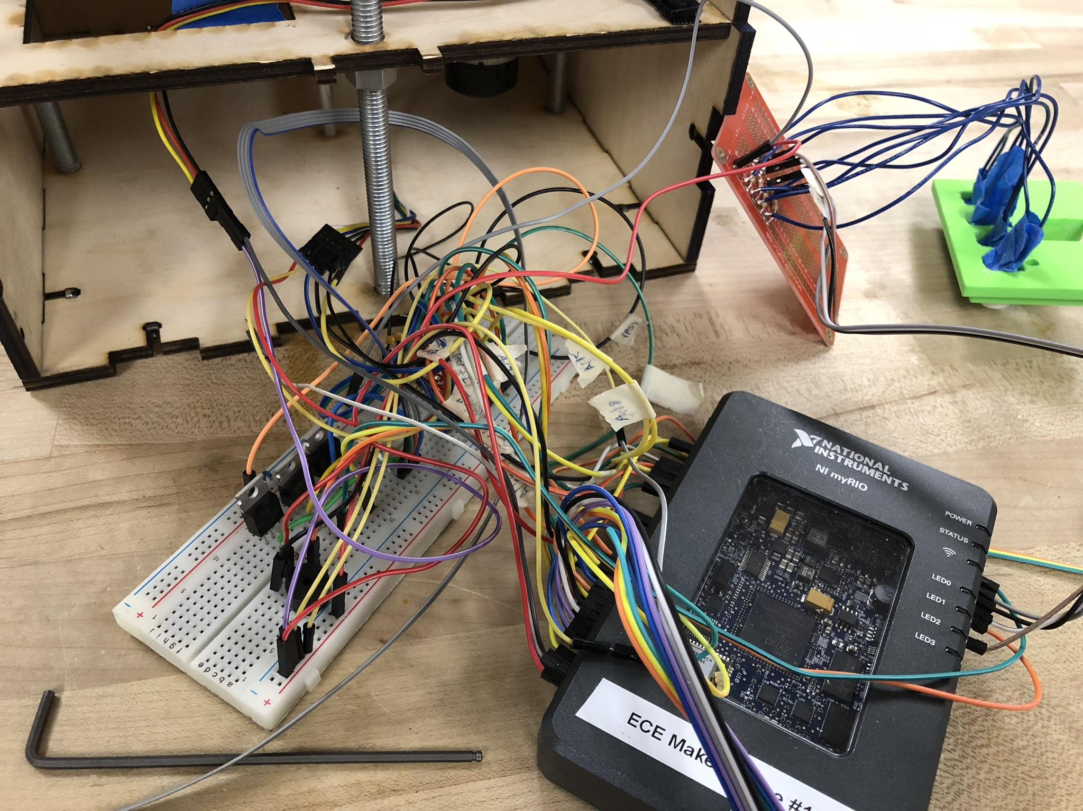
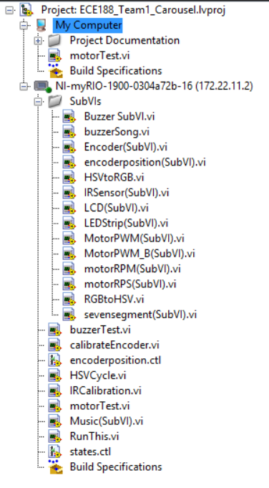
Challenges
Torque of motor
Gear teeths
Organizing
Friction
Shortage of wood

Slide 18
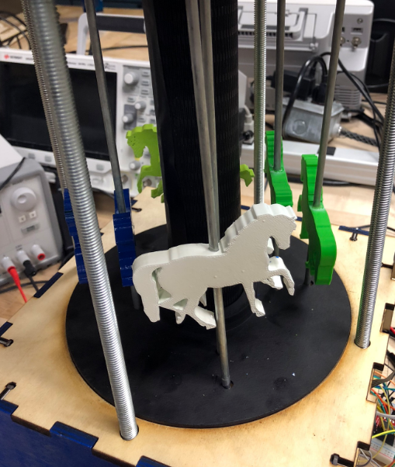
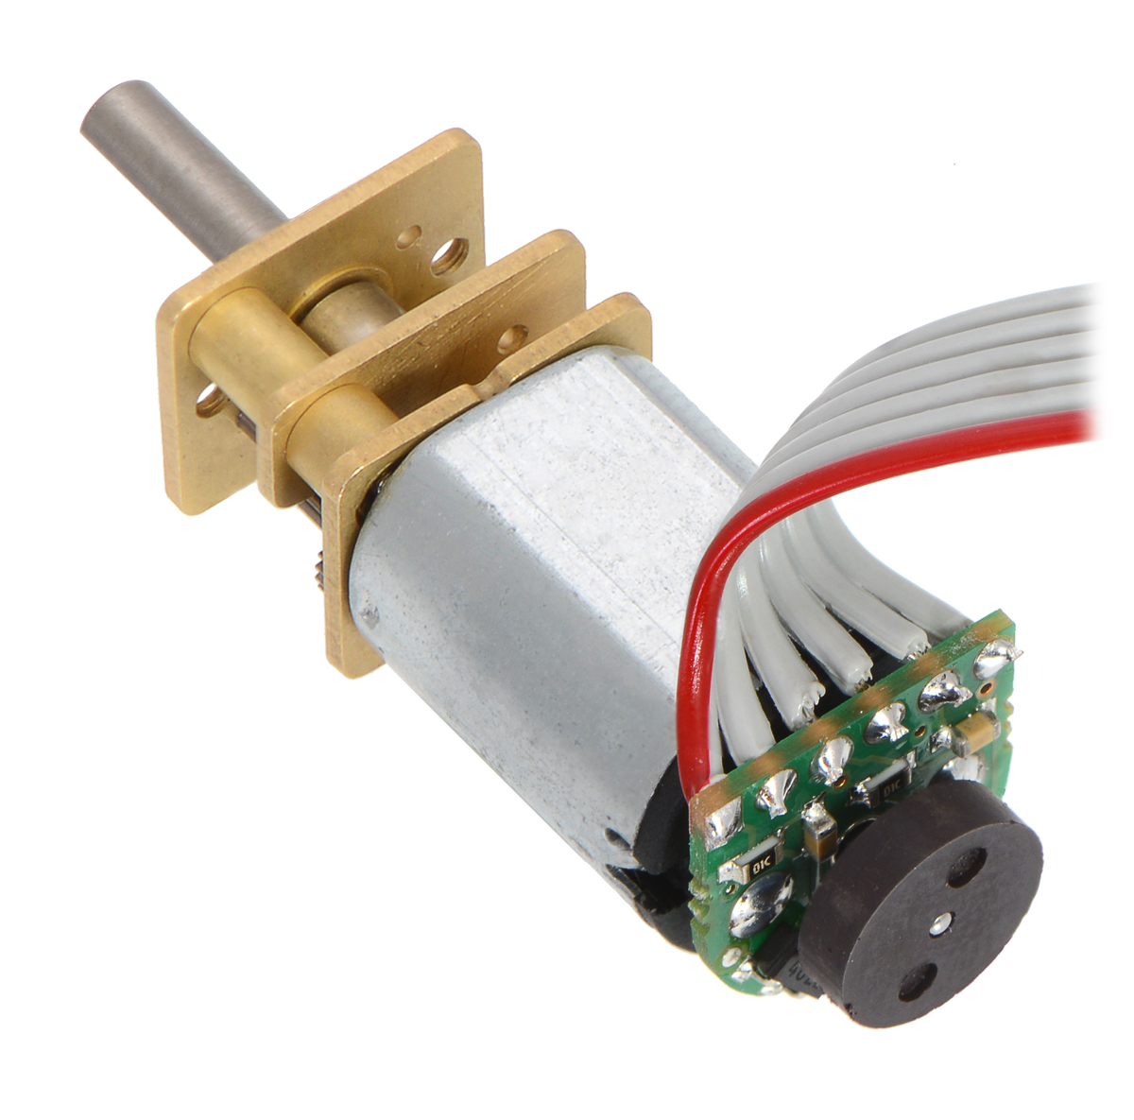
Potential Improvements
Use of Acrylic
3D horses
More buttons
Encoder for top motor
Organization
Soldered Circuits over Breadboard

Slide 19
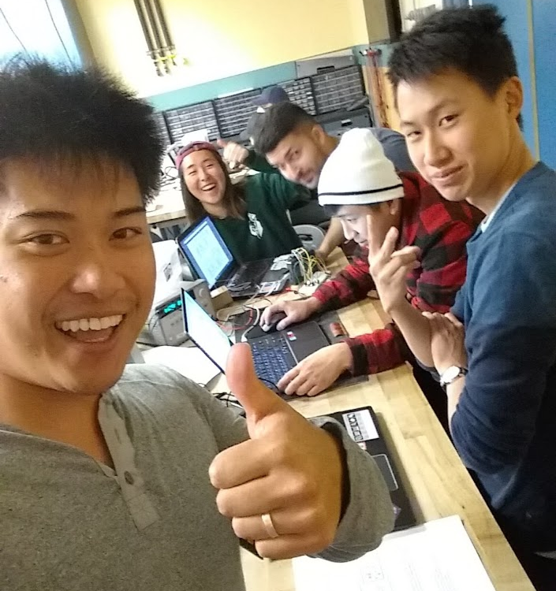
Thank you!
Questions?
Thank you!

Slide 20
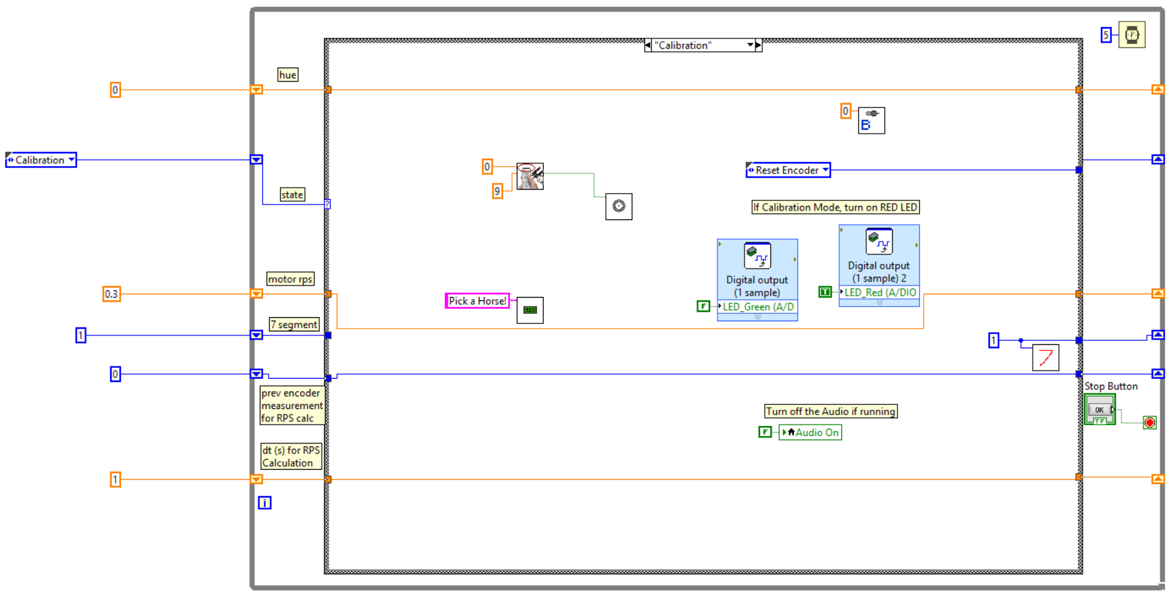

Slide 21
